Slide 1
UNDERSTANDING AND INTERPRETING DATA
THINKLOGIX (CANADA)
TRAINER: AJITPAL BRAR

Slide 2
COLUMN DATATYPES
THREE TYPICAL PHASES OF DATA ANALYTICS PROJECT:
Data Preparation,
Exploratory Data Analysis (EDA)
Data Visualization

Slide 3
COLUMN DATATYPES
Data Science/ML/AI
BI/Analytics/Reporting
Data Preparation
EDA
Prediction/Classification
Data Visualization

Slide 4
IMPORTANCE OF BUSINESS QUESTIONS
Right business questions help you to determine the actual requirements for the project
Project Selection (or typically understanding Aim/Outcome/Impact) phase certainly require you to ask the right business questions
Right Business Questions helps you to chose correct Variable of Interest

Slide 5
DATA ANALYSIS
Descriptive Analysis
In descriptive analysis phase, you reveal the fundamental characteristics of data such as data type, frequency tables, distribution etc.
Univariate Analysis – Analysis of single variable
Bivariate Analysis – Analysis of two variables in correlation to understand impact of one on another

Slide 6
UNDERSTANDING YOUR VARIABLES
Variable Types
Numeric/Discrete – Data Available in numeric form with specific step size
Numeric/Continuous – Data Available in numeric form without specific step size
Character/Categorical – Data representing some sort of groups

Slide 7
TYPICAL JOURNEY AND CLASSIFICATION OF DATA
SAS/SQL/
Tableau/Power BI
R/Python/
Scala/ML.NET
PAST
FUTURE
Business Intelligence
Business Analytics
Reporting
Dashboard
KPIs/Metrics
Model(Explanatory)
PRESENT
Data Science
Predictive Modeling
Machine learning
AI

Slide 8
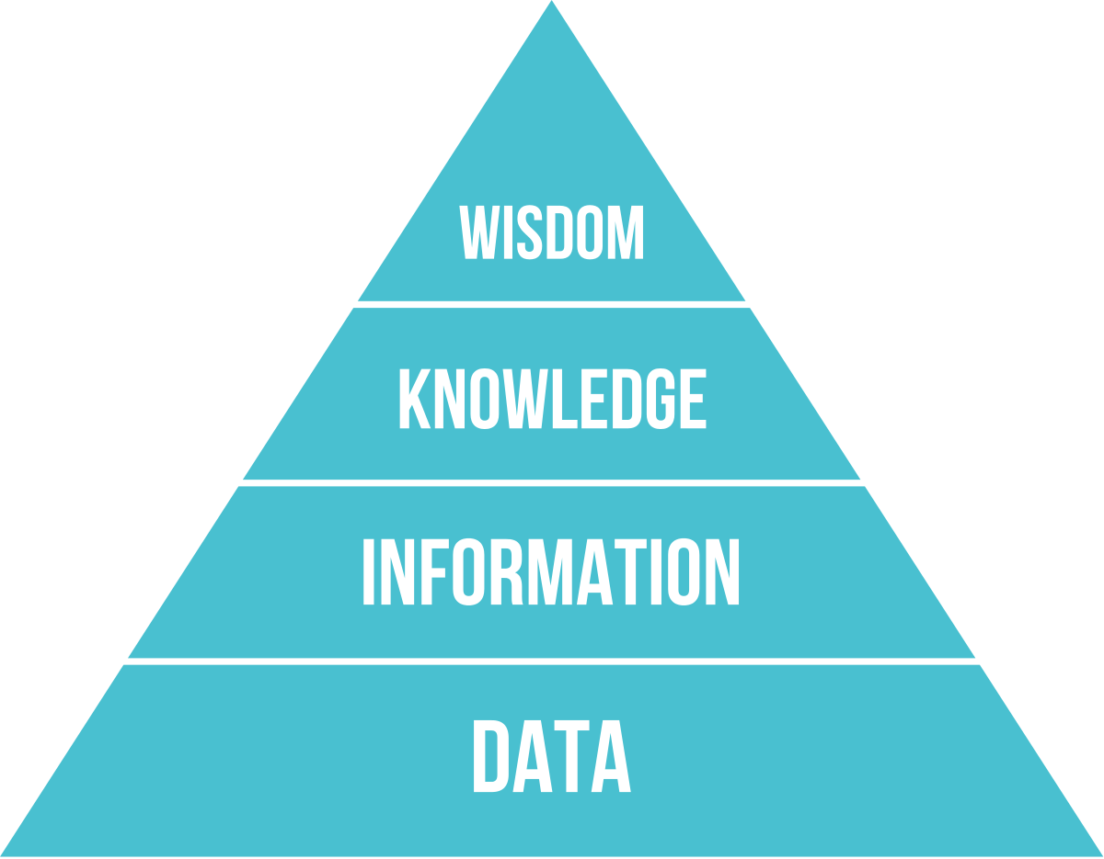
DIKW PYRAMID

Slide 9
DIKW PYRAMID
WHY
HOW
WHAT
Most of marketing budget should be spent on these age groups.
23, 28, 30, 31, 50, 40, 51, 52
RAW DATA
You determined if its age
Customers buying most frequently falls in 20-29 and 40-50.
WISDOM
KNOWLEDGE
INFORMATION
DATA

Slide 10
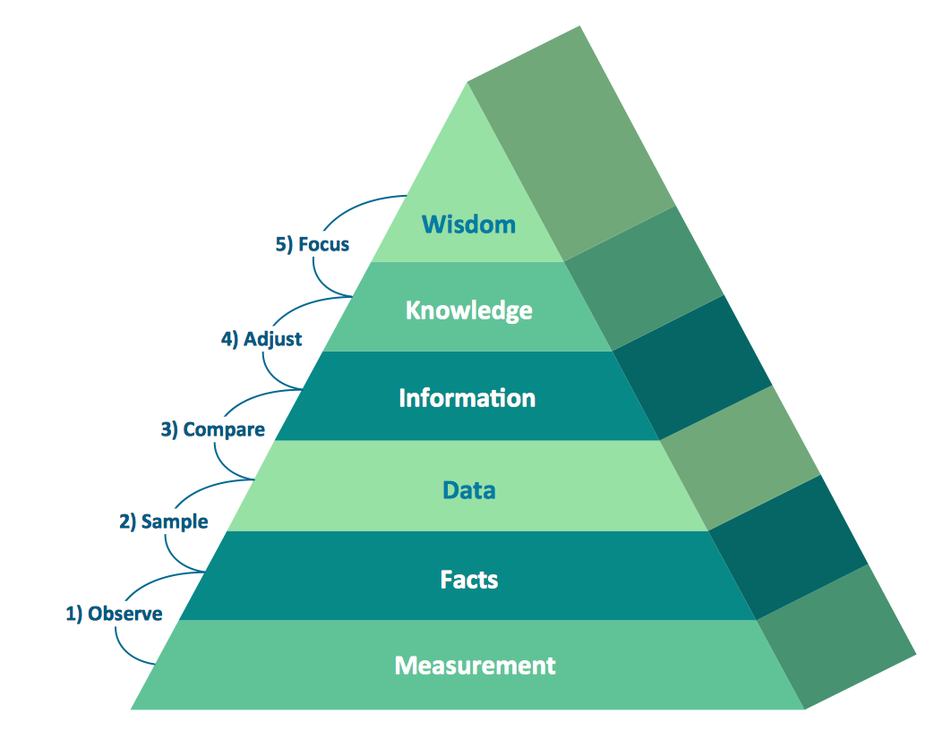
DIKW PYRAMID Ref: https://medium.com/@stangarfield/yet-another-myth-the-dikw-pyramid-scheme-a059ba595b30

Slide 11
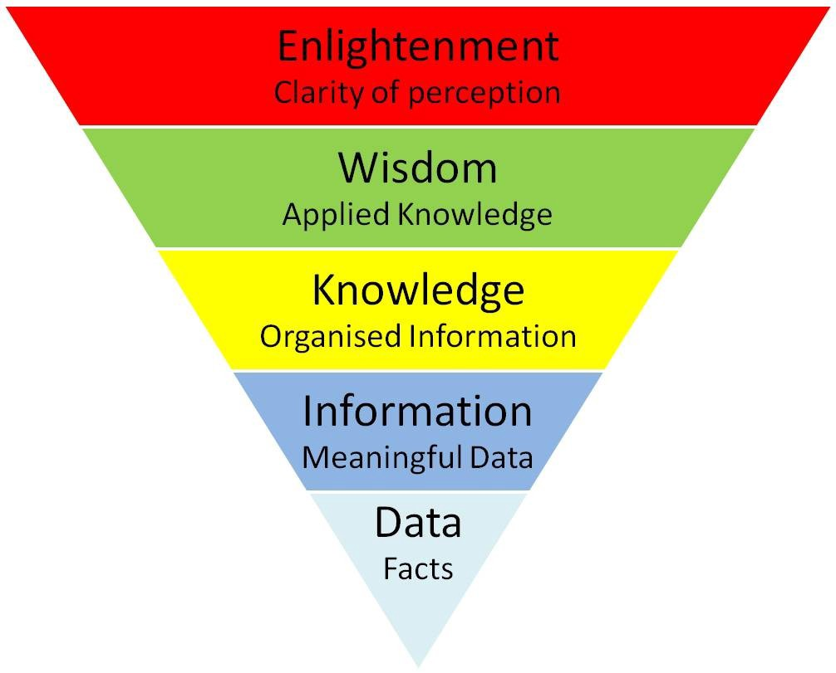
DIKW PYRAMID Ref: https://medium.com/@stangarfield/yet-another-myth-the-dikw-pyramid-scheme-a059ba595b30

Slide 12
Work on Project Tasks
Data acquisition
Ask Right Questions according to your understanding of business
Understanding the data
Again ask right questions according to your understanding of data & business
Understanding the data analysis process
Apply your knowledge to obtain the basic results

Slide 13
THANK YOU
Website: www.ThinkLogix.io
Instructor: Ajitpal Brar

